Slide 1
Early Fish Degradation Trigger
Alert System
Automated Early Warning for Seer & Tuna Freshness
Author: Sowmya Maddala
Date: August 2025

Slide 2
Executive Summary
Fish spoilage is fast, costly, and impacts safety.
Traditional inspections are slow, subjective, and reactive.
Our system uses multiple sensors to detect early spoilage.
Provides automated, real-time alerts, enabling proactive actions.

Slide 3
Motivation
Problem: Delays in detecting spoilage lead to financial loss and safety risks.
Current Limitations: Manual checks are inconsistent and slow.
Goal: Early detection using sensor-driven, data-based alerts.

Slide 4
Data Collection
Species: Seer (229 points) & Tuna (195 points)
Timeline: September 2021, from fresh → spoilt
Sensors: H₂S, NH₃, Temperature, Humidity, CO₂, O₂, VOC
Frequency: Every 5 minutes (configurable)
Captures full degradation progression for model training.

Slide 5
Methodology Overview
Step 1: Data Cleaning & Imputation
Step 2: Compute Rolling Statistical Features (mean, median, z-score, ROC, relative ROC) and their quantiles.
Step 3: Initial Change Point Detection (per sensor)
Step 4: Multi-statistic Consensus Filtering
Step 5: Multi-sensor Fusion (≥2 sensors confirm)
Step 6: Model-based Confirmation (spoiling indices & levels)
Data
Stats
CP
Fusion
Alert

Slide 6
Rolling Statistical Features
Mean & Median: track gradual drift
Z-score: identifies deviations from local trend
Rate of Change (ROC): detects sudden spikes
Relative ROC: captures percentage changes
Dynamic Thresholds: quantiles adapt to trends

Slide 7
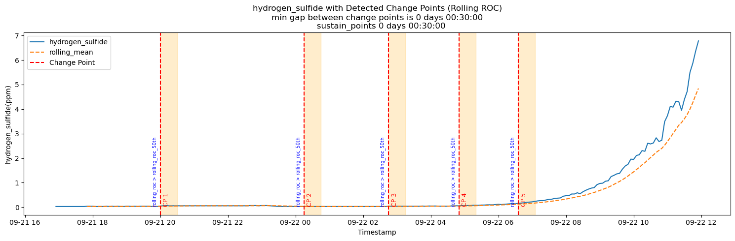

Slide 8
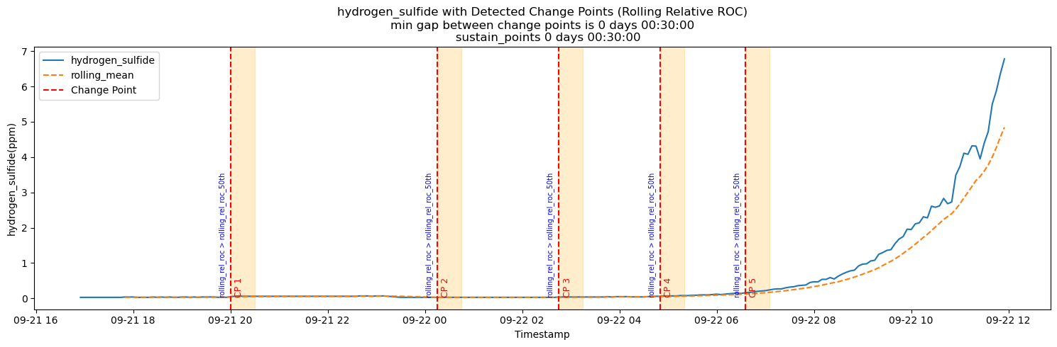

Slide 9
Change Point Detection
Candidate CP: rolling statistic exceeds local threshold ≥ 30 min
Per-sensor consensus: ≥2 statistics agree
Multi-sensor fusion: ≥2 sensors must detect CP
1-hour minimum separation after final CP

Slide 10
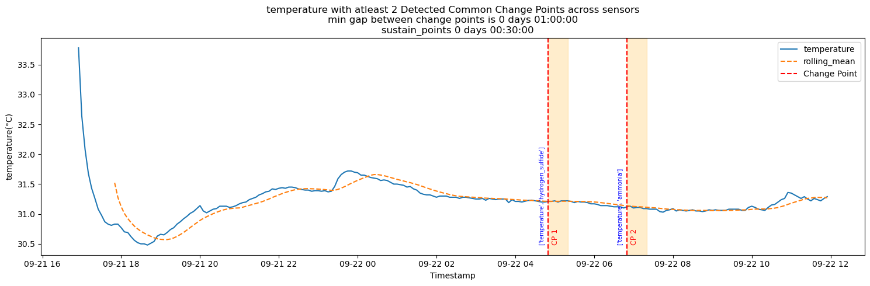

Slide 11
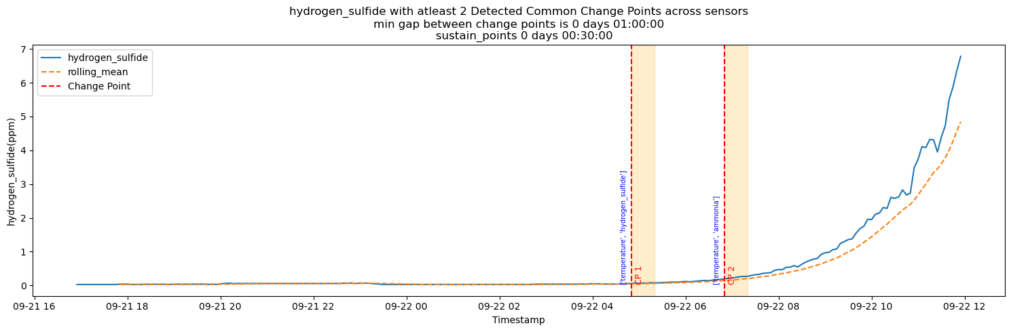

Slide 12
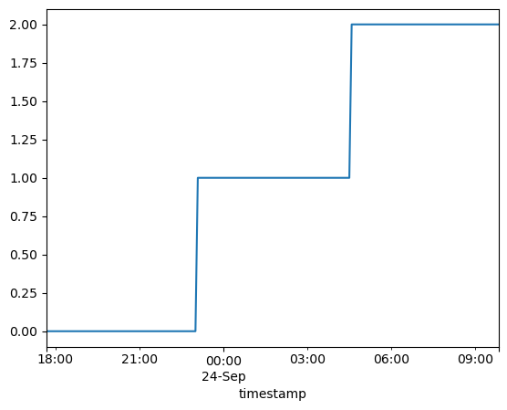
Label Engineering
Spoilage Index (0–1): Linear, Sigmoid, Exponential
Spoilage Levels (0–2): Fresh, Medium, Spoiled
Time-to-Spoil: Remaining shelf life estimation

Slide 13
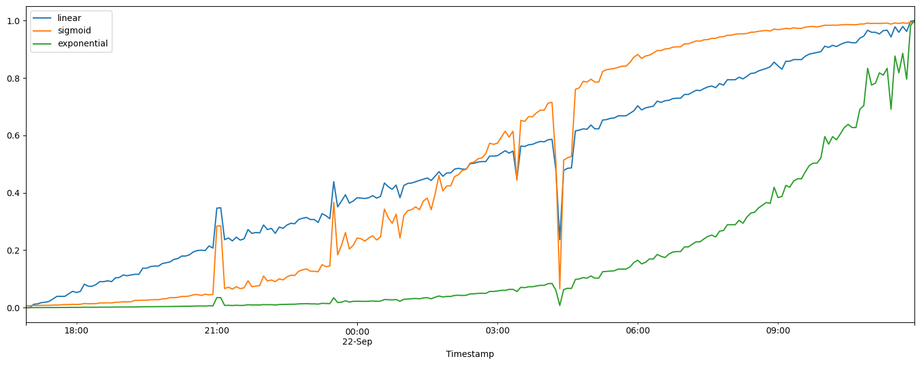
Spoilage Index Predictions

Slide 14
Machine Learning Layer
Regression Models: Linear, Random Forest, Gradient Boosting → spoilage index & time-to-spoil
Classification Models: Random Forest, SVM → spoilage levels
Model Gating Thresholds: Linear ≥0.3, Sigmoid ≥0.3, Exponential ≥0.1, Level ≥1.

Slide 15
Results & Insights
Early detection several hours before visible spoilage
Reduced false positives by ~40%
ROC & rROC most impactful
Exponential behavior confirmed for H₂S & NH₃

Slide 16
Business Impact
Waste Reduction: remove spoilt lots early
Supply Chain Efficiency: reroute or sell early
Food Safety: prevent spoiled fish reaching consumers
Cost Savings: minimize losses, extend shelf life

Slide 17
Limitations & Assumptions
Synthetic labels used (no real spoilage ground truth yet)
Baselines may vary by storage, season, and handling

Slide 18
Future Improvements
Forecasting for ahead-of-time spoilage prediction
IoT integration for real-time automated alerts
Online deployment for live streams
Adaptive thresholds per species and environment

Slide 19
Conclusion
Combines rolling statistics, multi-level consensus, and ML-based gating
Early, reliable, and interpretable spoilage alerts
Robust to missing data
Flexible & scalable for real-world seafood supply chains

Slide 20
Thank You

